Slide 1



THE WHITE HOUSE VISITORS LOG
THE WHITE HOUSE VISITOR LOG ANALYSIS AND TRENDS
The main objective of the presentation is to showcase trends in visitor access and appointments during key timeframes. We aim to examine how appointment patterns evolve over time, identify the most frequented locations, and determine when visitors tend to arrive.

Slide 2

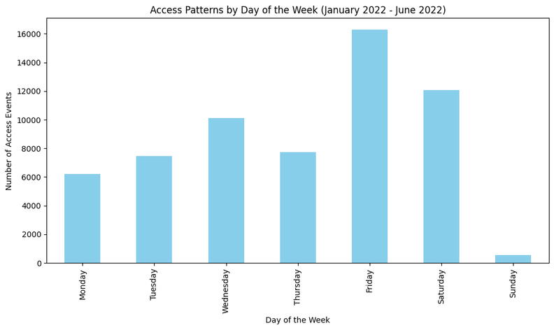

OVERVIEW OF DAILY VISITS AGGREGATED JAN 2022 - JUNE 2022
Audience:
Facility managers, security personnel, or operational planners responsible for managing visitor access to a building or complex.
Enhancing staffing and resource allocation for peak days such as Friday and Saturday, while considering a reduction in staff during lower-traffic days like Sunday.

Slide 3
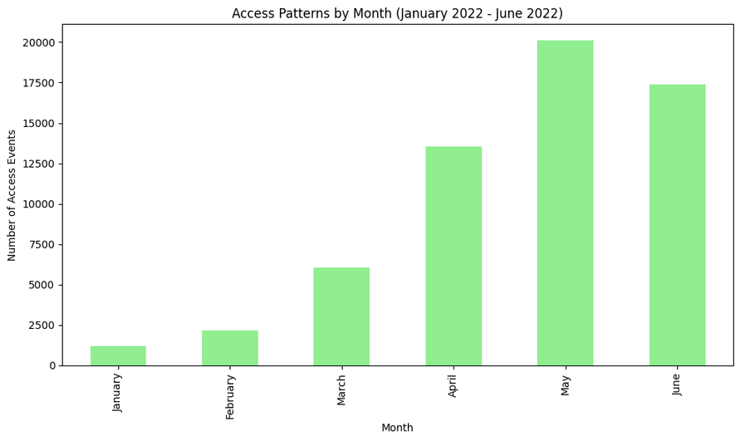

This chart is designed for event planners, operations managers, security personnel, and decision-makers who aim to analyze access trends over time to optimize resource distribution.
The chart illustrates access trends from January to June 2022, indicating a rise in visitor activity from March through June. This highlights the necessity for resource reallocation during peak months while suggesting a reduction in resources during the quieter months of January and February.

Slide 4
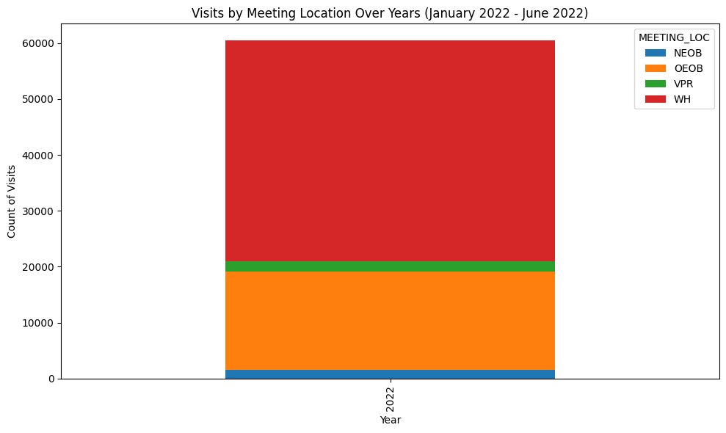


This chart is designed for meeting coordinators, logistics teams, or executive personnel overseeing visits to different meeting venues within a large facility, such as the White House. Their goal is to enhance the utilization of meeting spaces and allocate resources effectively according to the specific meeting locations.
THE STACKED BAR CHART ILLUSTRATES THE NUMBER OF VISITS TO DIFFERENT MEETING LOCATIONS FROM JANUARY TO JUNE 2022. IT REVEALS THAT THE WHITE HOUSE (WH) RECEIVED THE HIGHEST NUMBER OF VISITS, FOLLOWED BY THE OEOB, WHILE THE NEOB AND VPR HAD SIGNIFICANTLY FEWER VISITS.

Slide 5
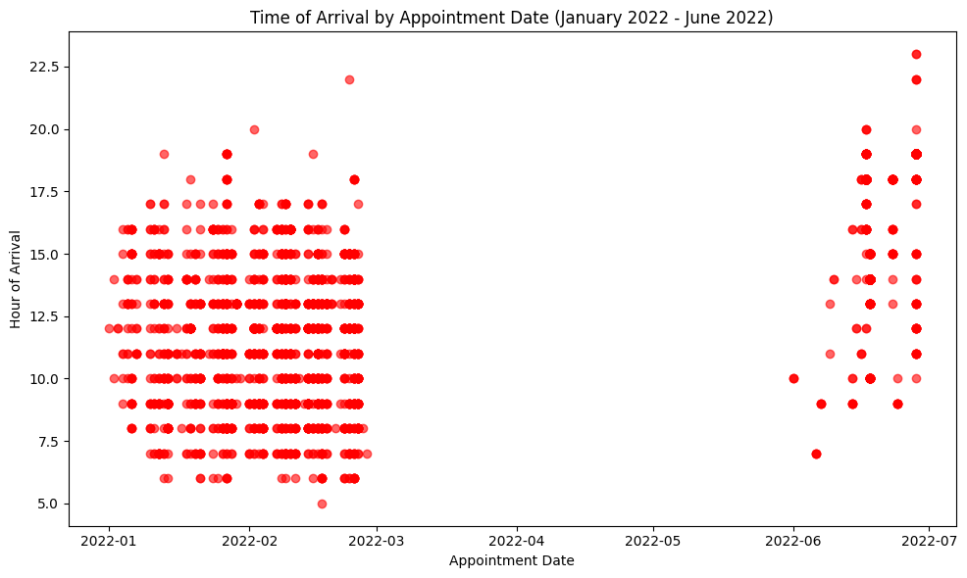

This chart aids facility managers, operational planners, and security teams in managing visitor access by providing insights into common arrival times. It helps optimize staffing, security, and resource allocation during peak periods.
THIS SCATTERPLOT SHOWS THE DISTRIBUTION OF VISITOR ARRIVAL TIMES FROM JANUARY TO JUNE 2022, HELPING TO IDENTIFY ARRIVAL PATTERNS AND UNUSUAL SPIKES OR GAPS.

Slide 6
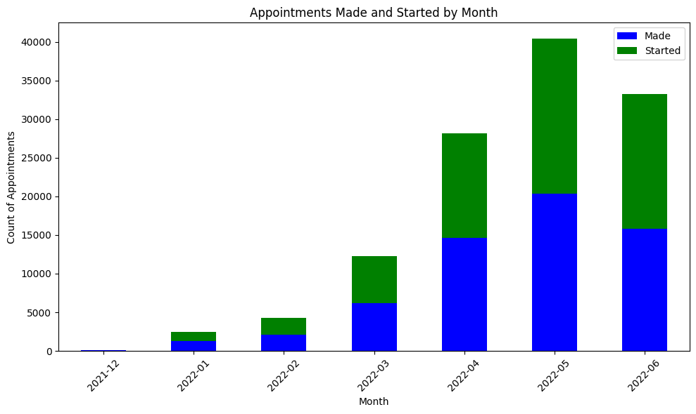

This chart is for operations managers, administrative staff, or executive leadership responsible for monitoring and managing appointments at a facility. It shows how appointment scheduling fluctuates across months, providing insights into operational demands and planning.
THIS STACKED BAR CHART DISPLAYS THE NUMBER OF APPOINTMENTS SCHEDULED AND COMPLETED FROM DECEMBER 2021 TO JUNE 2022. BLUE BARS REPRESENT SCHEDULED APPOINTMENTS, WHILE GREEN BARS REPRESENT COMPLETED APPOINTMENTS, ALLOWING VIEWERS TO EASILY IDENTIFY TRENDS AND DISPARITIES. BOTH CATEGORIES SHOW AN INCREASING TREND OVER TIME.

Slide 7
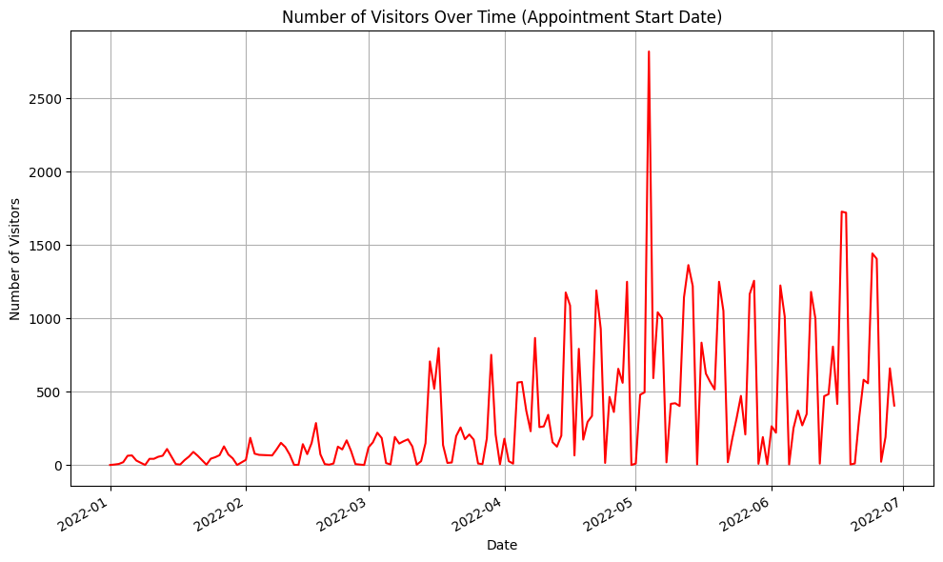

TThe chart visualizes visitor numbers based on appointment start dates from January to July 2022, showing daily fluctuations and highlighting peak visitor activity around May.
THE LINE CHART IS FOR FACILITY MANAGERS, EVENT COORDINATORS, OR SENIOR LEADERSHIP TO MONITOR VISITOR TRAFFIC OVER TIME AND OPTIMIZE SCHEDULING, SECURITY, AND RESOURCE ALLOCATION.

Slide 8
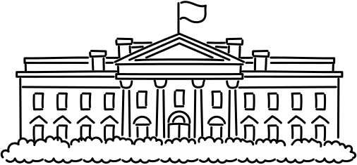
To summarize, we present a data-driven recommendation aimed at optimizing visitor management informed by access data trends. The proposed action is to approve scheduling adjustments that will improve visitor flow and minimize operational bottlenecks. To ensure clarity and effectiveness, we will utilize a PowerPoint presentation featuring well-crafted, visually engaging charts designed in accordance with Gestalt principles.

